Slide 1
Loading & Preprocessing Data
The Precursor to Success
OPER 785: Machine Learning II: Deep Learning
Lecture 04

Slide 2
Working with Real Data Sets
OpenML.org (https://openml.org)
Kaggle.com (https://kaggle.com/datasets)
UC Irvine Machine Learning Repository (https://archive.ics.uci.edu/ml)
Amazon Web Service (https://registry.opendata.aws)
Tensorflow data sets (https://tensorflow.org/datasets)

Slide 3
“The Journey of 1000 Miles Begins with a Single Step”

Slide 4
Things to Consider
Purpose
What will I use the data for?
What question(s) am I trying to answer?
Format
What format is my data going to come in?
What format do I need my data to be in?
Completeness/Level of Curation
Are there holes in the data?
How well is it maintained?

Slide 5
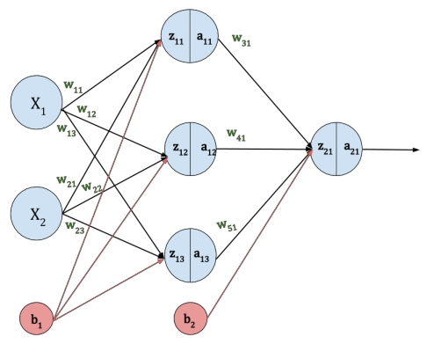
What goes into ANNs?
We are primarily concerned with ANNs, which take numeric values as inputs. Therefore, our data must be numeric.

Slide 6
Lesson Outline
Introduction
Importance of Loading & Preprocessing
Cleaning and Preparing Data
Loading & Preprocessing in Tensorflow
Data API
Features API
Image Preprocessing Discussion
Practical Examples Walkthrough

Slide 7
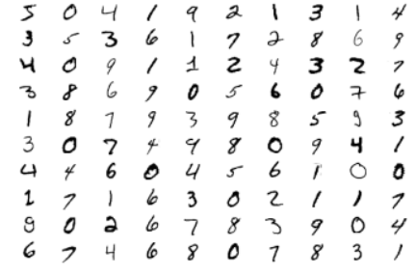
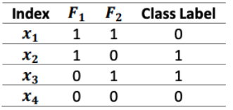
Loading Considerations
So far we have really only used/seen datasets that are able to fit into memory and in RAM
60,000 image Kera Dataset
XOR Dataset

Slide 8
Importance of Loading
Allows the ability to load very large datasets
Datasets are accessed from dataset object and not loaded into memory
Can then be transformed into desired format
Implement
Multithreading
Queuing
Batching
Prefetching
…etc

Slide 9
Exploring Your Data Set
Size (number of samples)
Factors
Number
Format
Completeness
Descriptive statistics
Correlations
Visualization
Histograms
Frequency
Density

Slide 10
Data Cleaning: Missing Data
If there are factors with missing data, you have 3 basic choices
Remove sample with missing field
df.dropna(subset=[“factor_name”], inplace=True)
Remove the factor from the analysis
df.drop(“factor_name”, axis=1)
Impute the missing data
Zero
Mean
Median
df[“factor_name”].fillna(value, inplace=True)
Examples are for use with Pandas DataFrame objects

Slide 11
Preprocessing: Text and Categorical
Not always convenient numerical fields
Text features
Categorical features
We want to convert complex features to numerical features

Slide 12
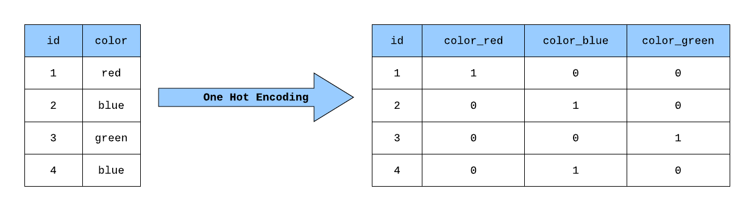
Preprocessing: Categorical
Categorical Features - Ordinal
Education Level Example
Categories: {None, School, University}
Ordinal encoding: None= [0], School= [1], University= [2]
One Hot Encoding: None= [1,0,0], School= [0,1,0], University= [0,0,1]
There are other strategies we won’t cover such as difference encoding (used by JMP)

Slide 13
Preprocessing: Feature Scaling
In general, machine algorithms do not perform well when features have widely different scales
Consider factors such as age and income. Income has a wider scale and larger magnitude that makes numerical methods biased toward the income factor
Two general methods for combating this issue
Min-max scaling (normalization) -> [0, 1]
Greatly affected by outliers
Standardization x’ = (x – x_{mean})/s_{x}
Less affected by outliers
Other custom transforms exist

Slide 14
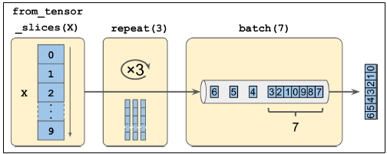
Chaining Transformations
Transformation methods may be chained
Take in/return dataset objects
Transformation methods may be chained
Methods natively support multithreading
Transformations applicable to individual items or whole sets
map() versus apply()
filter() and take()

Slide 15
Crossed Categorical Features
Creates interaction term between categorical variables
Generates hash of all variable combinations
Modulos hash values based on defined bucket size
Returns Cross Category ID
May also be used on bucketed numerical variables

Slide 16
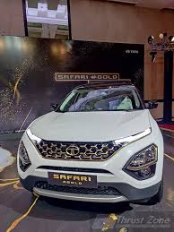
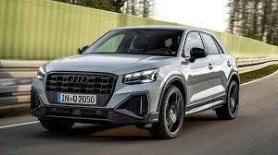
Image Preprocessing
Uniform aspect ratio

Slide 17
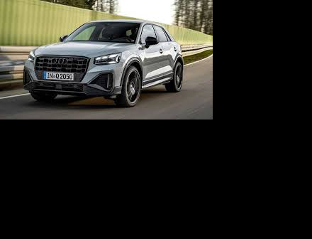
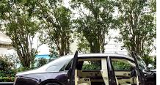
Image Preprocessing
Cropping Padding Scaling

Slide 18
Image Preprocessing
Whatever method or combination of methods you choose to use for your training set should also be used to argument your validation and test set.

Slide 19
Image Preprocessing
Reducing the inputs
Feature Selection
Image augmentation
Why do we want to do this?
Helps with sparse datasets
Speed
Performance

Slide 20
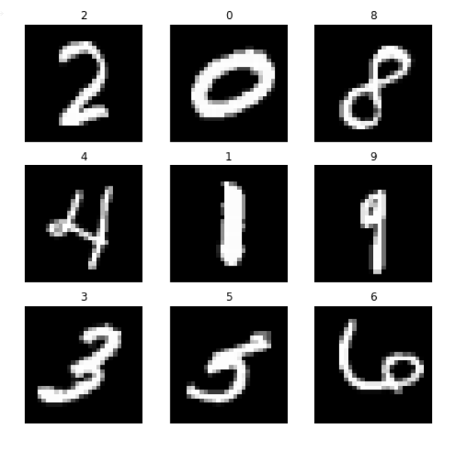
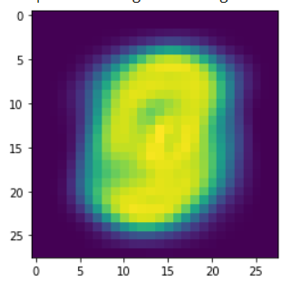
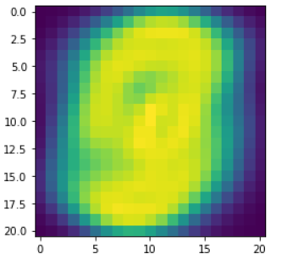
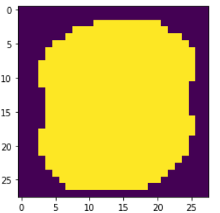
Image Feature Selection CNN

Slide 21
Possible Augmentations
Geometric
Color space
Kernel filters
Random erasing
Mixing images
“Ablumentations is a python library that works seamlessly with pytorch and tensorflow” -Lt Kimatian

Slide 22

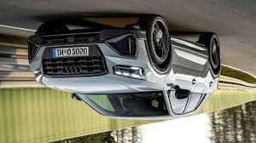
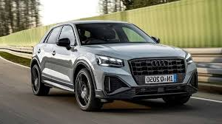
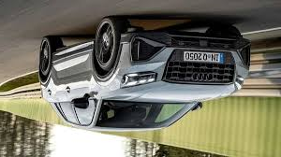
Geometric Augmentations

Slide 23
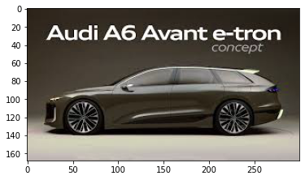
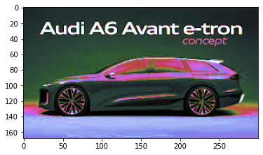
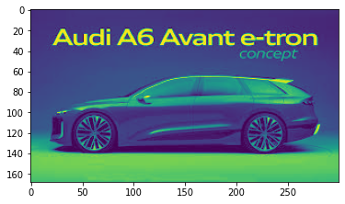
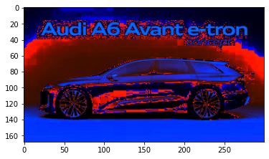
Color Space Augmentations

Slide 24
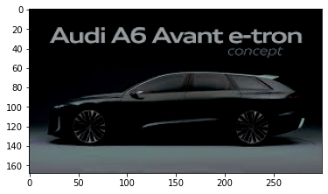
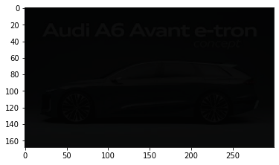
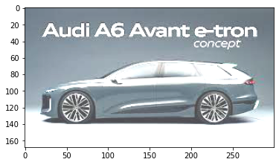
Additional Color Space Augmentations

Slide 25
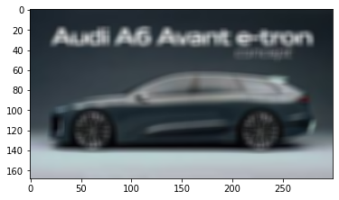
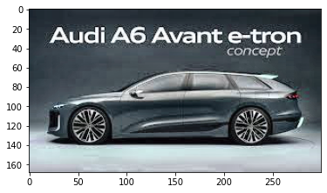
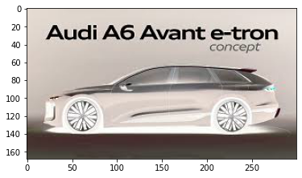
Kernel Space Augmentations

Slide 26
Practical Example Walkthrough

